Slide 1
Funeral
نماز جنازہ

Slide 2
Things To do
Inform to relatives and friends about the death and the time of Janazah.
Kafan.
Perform GHUSL.
Janaza Prayer
Prepare the Grave.

Slide 3
The Kafn
The Kafn are the grave clothes of the deceased.
It is desirable that the Kafn be of white material and of medium quality according to the status of the deceased.
Rasulullah said, "Do not use expensive cloth in Kafn because it will very soon decay."
It is PERMISSIBLE to prepare one's Kafn during one's lifetime. This will avoid last minute rush and inconvenience.

Slide 4
Kafn for male
The MASNOON Kafn for a male is three cloths.
IZAAR: A sheet of cloth from head to the feet.
QAMEES: A long sheet that has to be folded in half and an opening cut to allow it to be put on as a shirt.
LIFAFAH: A sheet from above the head to below the feet.

Slide 5
Kafn for male
Just two piece of cloth .i.e. Izaar and Lifafah will also suffice, but it is SUNNAT to have the three.
It is MAKROOH to use LESS than two without a valid reason.

Slide 6
The Grave (Qabr)
Graves are of two types:
Lahad “L” Shape: Where the ground and sides of the Qabr are firm then a recess should be dug on the Qiblah side to allow placing the body in the recess. Unbaked bricks should preferably be used to close the recess and made to fit neatly.
Shiq “Box” Shape: where the soft nature of the ground does not allow a LAHAD to be made then a shallow trench should be dug in the centre at the bottom of the Kabr to allow the body to be placed in this trench. Timber may be used to cover this. The use of any fabrics or blankets etc is undesirable and wasteful. The bamboo or planks must be cut to size and set to fit properly in the grave before burial to avoid last minute inconvenience.

Slide 7
Ghusl requirements
Clean lukewarm water.
A broad bench, stand or platform.
Two large buckets for warm water, one small bucket or utensil, this is for the water to be mixed with a little camphor for use at the end of the Ghusl.
Two jugs or mugs for pouring water over the corpse.
Leaves of BER tree (Zizyphus Jujuba) if easily available, to be mixed with the lukewarm water and a cake of soap.
250 g. of cotton wool.
Two Tehbands and two bag like mittens with strips.
A scissor for removing the deceased's clothing.
Lobaan (Frankincense-Aromatic gum resin obtained from trees) or any other Paak incense for smoking the bench, stand or platform.
One clean sheet to cover during Ghusl and one to cover before and after Ghusl.
One clean towel or a piece of material for drying the corpse.

Slide 8
Kafn for Female
The MASNOON Kafn for a female consists of an IZAAR, KHIMAAR (Orni), QAMEES.
LIFAFA is a piece of material to hold the breasts (SINA'BAND).
Khimaar is the Veil. The piece of material to hold the breasts should preferably be from the breasts to the thighs.
Three garments i.e. Izaar, Lifafah and Khimaar will suffice, but it is SUNNAT to have FIVE.
It is MAKROOH to use less than THREE, except when it is NOT available.
It is the duty of the husband to bear the burial expenses of the wife.
The Kafn could be smoked with LOBAAN etc. but NOT scented with Itr. Children's Kafn should be cut to appropriate size.

Slide 9
Who should perform the ghusl?
The Ghusl is the bath for the body of the dead person.
An adult male should be bathed by his FATHER, SON or BROTHER.
An adult female by her MOTHER, DAUGHTER or SISTER.
If none of these persons are present then any : near relative could carry out this duty, (male for male, and female for female).
If any of these are not in the position to perform the Ghusl, then the most pious person present should be requested to carry out this rite.
The person giving the Ghusl should be assisted by others. The person performing the Ghusl must himself or herself be Paak and in a state of Wudhu. It is MAKROOH for a woman who is MENSTRUATING or in a state of NIFAAS (period after birth of a child) to perform the Ghusl.
If a MALE passes away and there are NO MALES to bathe him, then no other woman besides him WIFE is permitted to carry out the Ghusl.
In the case of a WOMAN, if there are no LADIES to perform the GHUSL, the HUSBAND CANNOT perform the Ghusl of his WIFE.
In both instances TAYAMMUM should be performed. The Tayammum for Ghusl is the same as that for Wudhu.
A CHILD who has NOT reached the age of PUBERTY (Male or Female) may be given Ghusl by any adult, male or female, if a member of the same sex is not available.

Slide 10
The Ghusl (MASNOON SEQUENCE)
A bench, stand or platform on which the Ghusl will be carried out must be washed, cleaned and fumigated with Lobaan or any other Paak aromatic, three, five or seven times During GHUSL it is PERMISSIBLE to place the one of the following two positions:
WHICHEVER POSITION IS CONVENIENT IS PERMISSIBLE.
a. Having the LEGS facing the QIBLAH. b. Having the FACE towards the QIBLAH (as a person is made to lie in the grave.
However, it is preferable to place the body with the FACE towards the QIBLAH as NABI has mentioned that the Ka'ba is the Qiblah of both the living and the dead.
NO HAIR of the head, beard or any other part of the body must be cut, shaved, trimmed or combed. The nails too should NOT be cut. Circumcision is also NOT permissible. All rings, jewelery wigs etc. should be removed. Where the false teeth of the dead person can easily be removed, these should preferably be taken out.
Thereafter the body should be put on the stand, the SATR (private parts) covered (The male's Satr from the navel to the knees and the female's from above the breast to the ankles).
The stomach should gently be massaged then both the Istinja places should be washed with mittens on without looking at the private parts.
The nostrils, ears and mouth should be closed with cotton wool to prevent water from entering the body during the Ghusl.
If the deceased has reached the age of puberty and was one on whom Namaaz was Farz, he must be given WUDHU. This Wudhu is similar to that of Namaaz with the exception of GARGLING and putting water into the NOSTRILS.

Slide 11
The Ghusl (MASNOON SEQUENCE)
The proper sequence should be to wash: -
1. The FACE. 2. ARMS to the ELBOWS. 3. MASAH of the HEAD and 4. FEET up to the ANKLES.
If the dead person is in the state of JANAABAT, HAIZ or NIFAAS (a state in which GHUSL is WAAJIB on him/her), then the mouth HAS TO be gargled and nostrils be made wet. This can be done with a little bit of cotton wool.
After Wudhu, the head and beard should first be washed with soap or any other cleansing agent. If these are not readily available, pure clean water will suffice. The temperature of the water must be that which a living person normally uses when bathing.
Thereafter the body should be tilted onto it's left side to allow the right side to be washed first. Warm water should now be poured over the body from head to the toes once and the body should be washed with soap until the water has reached the bottom (left side). The body should now be washed again twice by pouring water from head to toe . The body should then be turned onto it's right side and the left side bathed similarly.
Thereafter the body should be lifted slightly to a sitting position and the stomach be gently massaged with a downward stroke. Whatever comes out of the body should be washed away. The WUDHU and GHUSL need NOT be REPEATED in case any impurity does come out.
The body should once again be turned onto it's left side and camphor water poured over it from head to toe three times.
All the cotton wool should now be removed from the mouth, ears and nose.
With this the Ghusl is complete and the body could be wiped with a towel or a piece of material. The SATR must be kept covered. The FIRST Tehband will be wet due to the Ghusl. It should thus be changed for a second one. Care should be taken that while doing this the SATR is NOT exposed.
The body should then be wrapped in saheet and carried carefully onto the Kafn.

Slide 12
How the Kafn should be put on the male
First spread the LIFAFAH on the floor then on it the IZAAR and on it that portion of the QAMEES that will be under the body. The portion that will cover the top of the body should be folded and put at the head side.
Lower the body gently onto the Kafn and cover the top of the body upto the calves with the folded portion of the Qamees.
Remove the TEHBAND and sheet used for covering the SATR.
Rub ITR or HUNOOT on the HEAD and BEARD.
Then rub camphor mixture paste on the the places of SAJDAH (i.e. those parts of the body that touch the ground in NAMAAZ: forehead, nose, both the palms, knees and the fore feet).
First fold the LEFT flap and on it the RIGHT flap of the IZAAR over the QAMEES.
Thereafter fold the LIFAFAH in the same manner. Remember that the RIGHT flap must always be on the TOP.
Lastly fasten the ends of the LIFAFAH at the head side, feet and around the middle with strips of the cloth.

Slide 13
How the Kafn should be put on the Female
First spread the LIFAFAH out on the ground then the SINABAND on it the IZAAR and then the QAMEES in the same manner stated for males. The SINABAND may also be placed between the Izaar and Qamees or lastly over the Lifafah.
Lower the body gently onto the Kafn and cover the top of the body upto the calves with the folded portion of the Qamees.
Remove the Tehband and sheet used for covering the Satr. Do NOT use Itr, Surmah or any other make up.
Rub camphor mixture onto the places of Sajdah, i.e. the forehead, nose. both palms, knees and the fore feet.
The hair should be divided into two parts and put onto the right and left breast over the Qamees.
Cover the head and hair with the Orni. Do not fasten or fold it.
Fold the Izaar, the left flap first and then the right over the Qamees and Orni.
Now close the Sinaband over these in the same manner.
Close the Lifafah, the left flap first and then the right.
Lastly fasten the ends of the Lifafah at the head side, feet and around the middle with strips of cloth, to keep the complete Kafn in place.

Slide 14
The Janaazah Namaaz
The Janaazah Salaat is FARZE KIFAAYAH on all Muslims present. It consists of FOUR TAKBEERS, THANA, DUROOD, and a MASNOON DUA for the deceased and TWO SALAAMS. All these are said SILENTLY by both the Imam and the Muqtadis. Just the Imam should call out the Takbeers and Salaam aloud.
There are two farz in the Janaazah Namaaz: -
1. To stand and perform the Salaat. 2. To recite all the FOUR Takbeers.

Slide 15
The Masnoon manner of performing the Janaazah Namaaz
The body of the Mayyit should be placed with the head on the RIGHT side of the Imam, who will face the Qiblah.
The Imam should stand in line with the CHEST of the deceased whilst performing the Salaat.
It is MUSTAHAB to make an odd number of SAFS (rows.) The Safs for Janaazah Namaaz should be CLOSE to one another because there are NO Sajdahs to be made.
After the Safs are straightened the NIYYAT should be made. The Niyyat should be made thus: "I am performing this Janaazah Salaat for AIlah behind this Imam (The Salaat being a Dua for the Mayyit). After the Niyyah the hands should be raised upto the EARS and the Imam should say Allahu Akbar loudly and the Muqtadis softly. Then fold them under the navel similar to all daily Salaat.

Slide 16
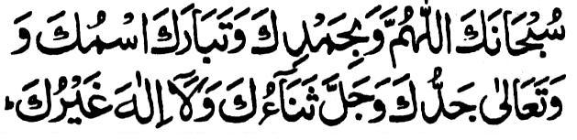
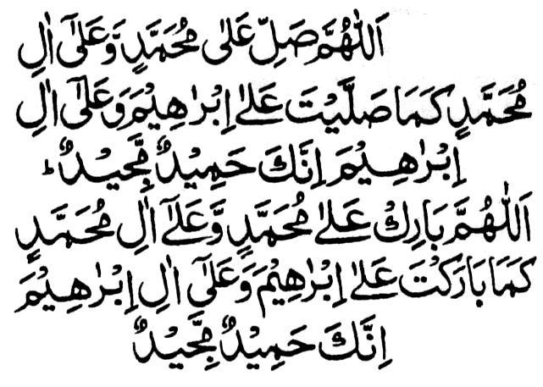
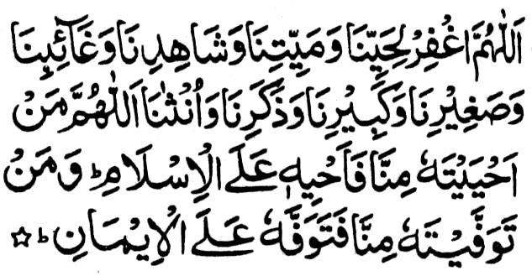
Qira’at in Janaza

Slide 17
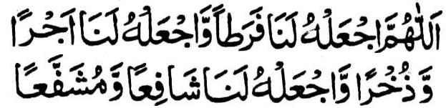
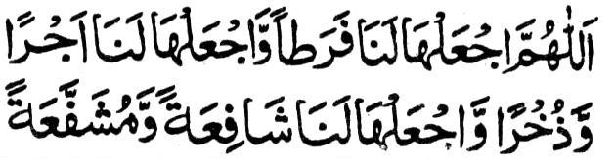

Slide 18
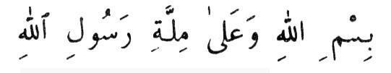
The Shar’ee method of Dafn (burial)
After the Janaazah Salaat is performed the Mayyit should be buried as soon as possible. The Janaazah should be carried and placed. at the Qiblah side of the grave. The head should be on the RIGHT SIDE side of the grave if one faces the QIBLAH.
It is desirable that MAHRAMS or close relatives (of a female Mayyit) should enter the grave to lower the body. The husband should NOT enter the grave to bury his wife. It is NOT MASNOON (Sunnat) that there be an ODD number. All those who enter the grave should face the Qiblah.
It is MUSTAHAB to hold a sheet over the grave while lowering and burying a female. If there is fear of her Kafn opening then it is WAJIB to do so.
It is MUSTAHAB for those present to recite this Dua whilst the body is being lowered:
After placing the body into the recess of the grave it is Masnoon to turn it onto it's RIGHT side to face the Qiblah.
The strips of cloth tied at the head side, chest and leg side should now be untied.
The recess should then be covered with unbaked bricks, bamboo or timber.

Slide 19
Period of Iddat
The period of WAITING after one's HUSBAND dies is called IDDAT. This period is of FOUR months and TEN days.
During this period she should remain in the dwelling that they occupied at the time of the death of her husband. She is NOT allowed to leave this house if she has sufficient provision. If she is the sole bread winner with no other means of income, then only is she permitted to leave her house during the day. At night she should return to his house.
The widow that is expecting a child at the time of the death of her husband, her Iddat will be until the birth of that child. The four month and ten days should NOT be reckoned in this instance.
If a woman is NOT at home at the time of her husband's death, she should return as soon as possible and pass the period of Iddat at home. The days of Iddat will be calculated from the time of the demise.
A woman in Iddat should abstain from using fancy clothing, make-up or jewellery.

